Slide 1


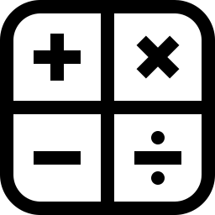


IPO Chart
INPUT | PROCESS | OUTPUT
The user either uses slider or keyboard mechanisms to input the values they want Restrictions: Varies on the program - Greater detail in the demo | The program finds the missing variable(s), calculating for it using kinematics, dynamics, Impulse and momentum, Fields, or wave formulas, depending on the unit the user chose | Using the variables, the program displays the animation according to the unit whether the animation is in 1-Dimension or 2-Dimension The program displays all the variables on the top of the screen for the user to see

